Slide 1

Disaster Prevention Quiz App
Team-5
Aug 30, 2024
Suzuki Tomohiro
Kaizu Shunichi
Ryuhei Hosoya
Xu Ziheng
Notes:
Good afternoon hello everyone
Our team is proposing a service called the Disaster Prevention Quiz App.this logo is our application logo lets begin

Slide 2


Introduction
Team-5
Many Disasters in Japan
Japan is a country that experiences a lot of natural disasters
(e.g. earthquakes, typhoons, tsunamis, and even volcanic eruptions)
The Japanese government has been warning
we might see a massive earthquake in the near future
(e.g. Nankai Megathrust Earthquake or Tokyo inland earthquake)
Because of all this,
awareness of disaster prevention has become stronger
※Japanese Cabinet Office：https://www.bousai.go.jp/kyoiku/hokenkyousai/jishin.html
Notes:
“So , as background, Japan is a country that experiences a lot of natural disasters—earthquakes, typhoons, tsunamis, and even volcanic eruptions. In fact, today in Saitama and Tokyo , we’re dealing with a typhoon that’s causing major damage like river flooding.
Also,, the Japanese government has been warning that we might see a massive earthquake in the near future, like the Nankai Trough or a Tokyo inland earthquake,. Because of all this, disaster prevention has become even more important.”

Slide 3
Priority actions theme
Team-5
World Conference on Disaster Reduction in 2015
① Understanding disaster risk
②Strengthening disaster risk governance to manage disaster risk
③Investing in disaster risk reduction for resilience
④: Enhancing disaster preparedness for effective response and to “Build Back Better” in
recovery, rehabilitation and reconstruction
Our team chose to focus on ①：understanding disaster risk
Notes:
In 2015, at the 3rd World Conference on Disaster Reduction held in Sendai, four priority actions were agreed upon to reduce disaster risks and impacts. Here are those four actions.
Out of these, our team chose to focus on the first one: understanding disaster risk.”
4o

Slide 4
Concrete Issue
Team-5
When we take a closer look at ①:understanding disaster risk,
we can identify the following issues
① Lack of knowledge about disaster prevention
People are scared of disasters, but they don't have much basic knowledge about disaster prevention because there aren’t many opportunities to learn
② Low awareness of disaster prevention
Even though people want to learn more, they don’t take the initiative to educate themselves since disasters are unpredictable, so they tend to put it off
We proposed a new and unique solution to solve
these issues by using Rakuten’s services.
Notes:
“When we focus on understanding disaster risk, we can identify the following issues:
1. Lack of knowledge about disaster prevention People are scared of disasters like earthquakes, but they don't have much basic knowledge about disaster prevention because there aren’t many opportunities to learn.
Low awareness of disaster preparedness Even though people want to learn more, they don’t take the initiative to educate themselves since disasters are unpredictable, so they tend to put it off.”
Our team thought that we might be able to solve these challenges by using Rakuten’s services.

Slide 5

Solution
Team-5
Disaster prevention
Disaster Prevention Quiz App
（楽天防災クイズ）
Notes:
The solution service is a ‘Disaster Prevention Quiz App’ this app combines disaster prevention with quizzes. By using the entertainment aspect of quizzes, we aim to make learning about disaster prevention fun and solve the two issues

Slide 6
How to solve
Team-5
Answer the quiz correctly, you can earn X times more Rakuten Points
By offering point rewards, even people who aren’t particularly interested in disaster prevention will be motivated to participate
Integrates with other Rakuten services
On the explanation pages of the quiz, we can feature ‘disaster prevention products from Rakuten market’ and ‘disaster-prevention recipes from Rakuten Recipe.’
This not only provides knowledge but also encourages real actions like purchasing products or making disaster-prevention meals.
Notes:
This service solves the issues by using these two methods.
First, when you answer the quiz correctly, you can earn X times more Rakuten Points. By offering point rewards, even people who aren’t particularly interested in disaster prevention will be motivated to participate, Second, it integrates with other Rakuten services. On the explanation pages of the disaster prevention quiz, we can feature ‘disaster prevention products from Rakuten Ichiba’ and ‘disaster-prevention recipes from Rakuten Recipe.’ This not only provides knowledge but also encourages real actions like purchasing products or making disaster-prevention meals.”
デモと楽天ポイントの付与方法が違う

Slide 7
Target User
Team-5
In Target
Rakuten market users who want to earn points
Rakuten members who want to acquire their disaster preparedness knowledge
Notes:
We are targeting the following audience
Rakuten market users who want to earn points and Rakuten members who want to enhance their disaster preparedness knowledge.

Slide 8
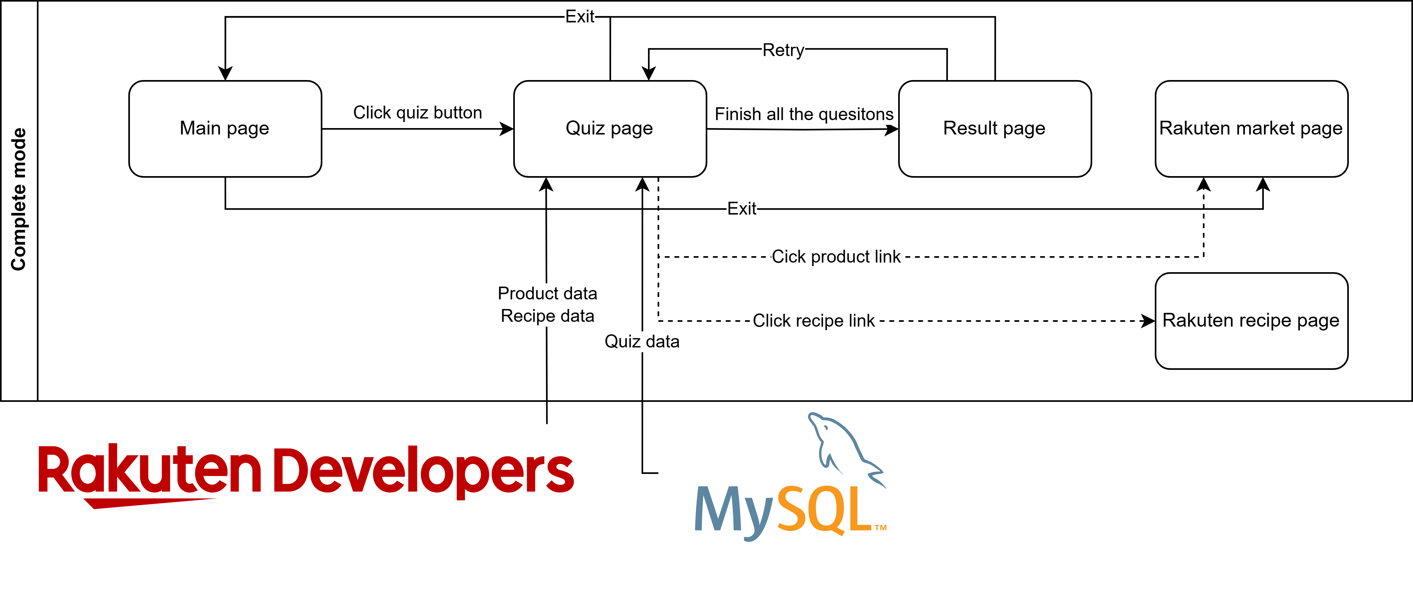
Product overview
Team-5
Product looks like this diagram
①Main Page（Rakuten market)
↓
②Quiz Page（Disaster Risk Reducation )
↓
③Result （Based on how many you get right, your Rakuten Points increase）
Notes:
Product overview looks like this diagram
The setup is that Rakuten Points increase based on the number of correct answers.
from the main page, like Rakuten market, to the quiz page, answer the questions, and then see your results. Based on how many you get right, your Rakuten Points increase.”

Slide 9



Related Technology
Team-5
We will introduce the service in the following order
①Frontend Technologies・・・Vite, React (JavaScript)
②API Technologies・・・Rakuten market, Rakuten Recipe
③Server Technologies ・・・ MySQL , Node.Js
④Prospects for the future
⑤Demo App introduction
Notes:
Afterwards 5:45

Slide 10

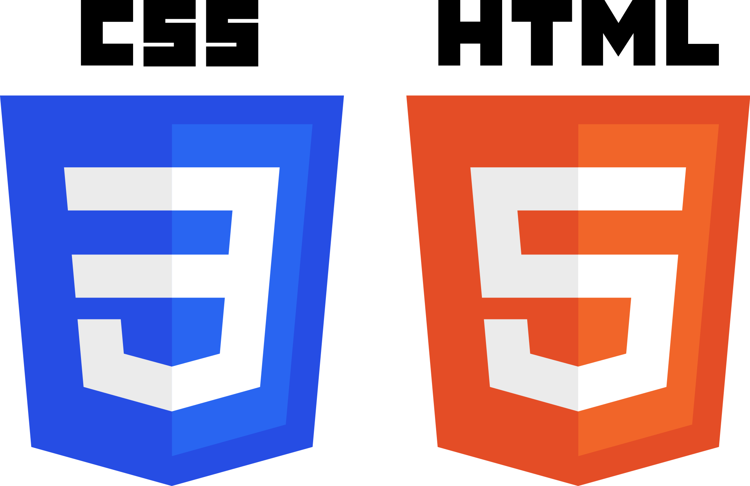
FrontEnd
Team-5
Frontend Technologies
Vite: Used as the build tool for the project.
React (JavaScript): Frontend framework.
HTML & CSS: For UI design and styling.

Slide 11
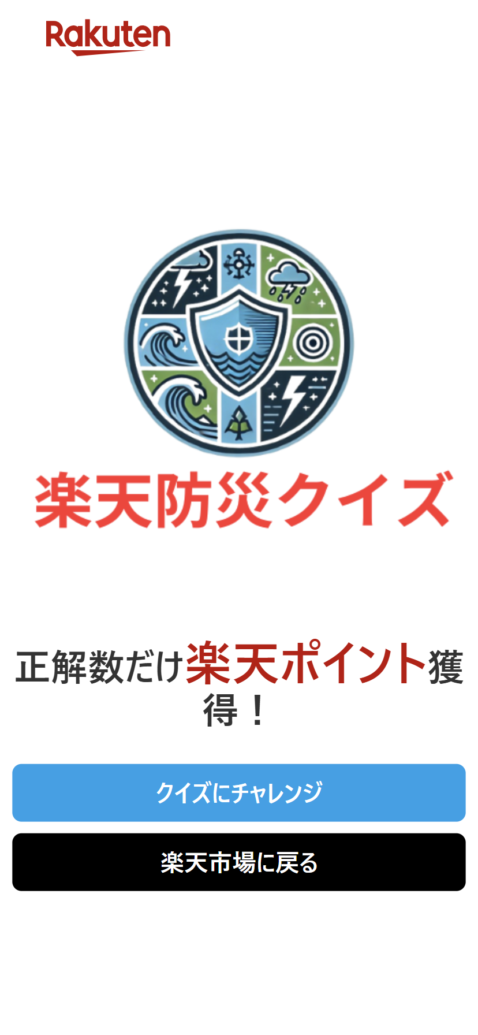
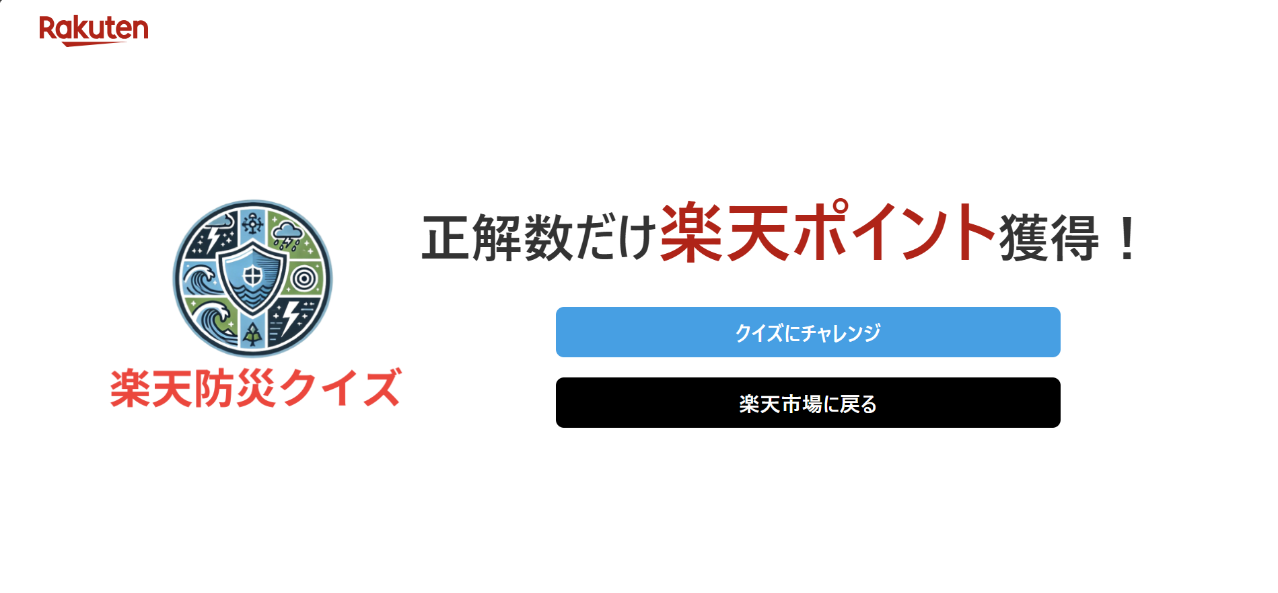
FrontEnd
Team-5
Frontend Features(Title Screen)
Key Improvements
・Enlarged the text of Rakuten points.
・Easier to see the balance of placement.
・Used the Rakuten logo on the header

Slide 12
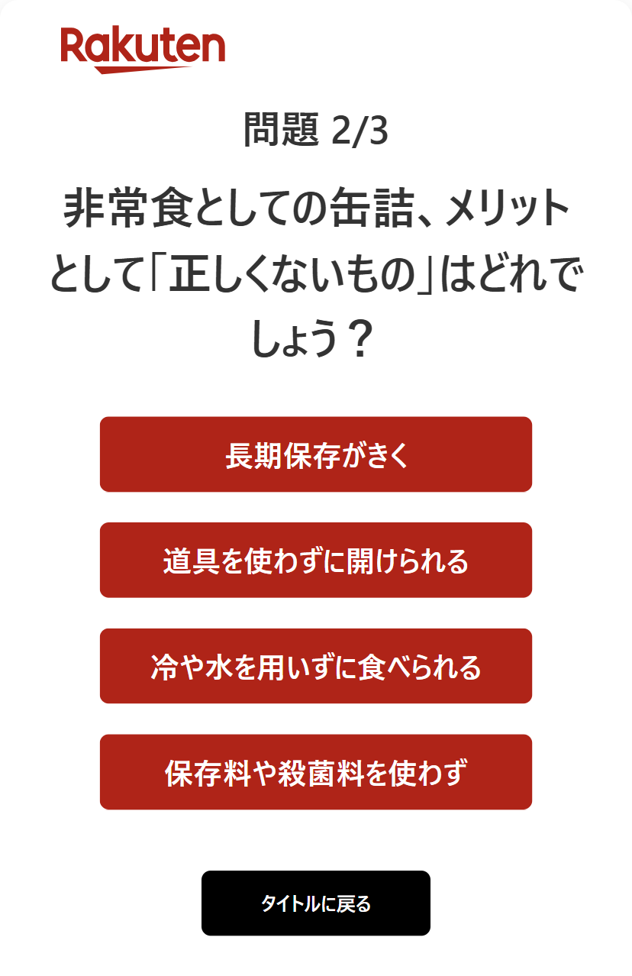
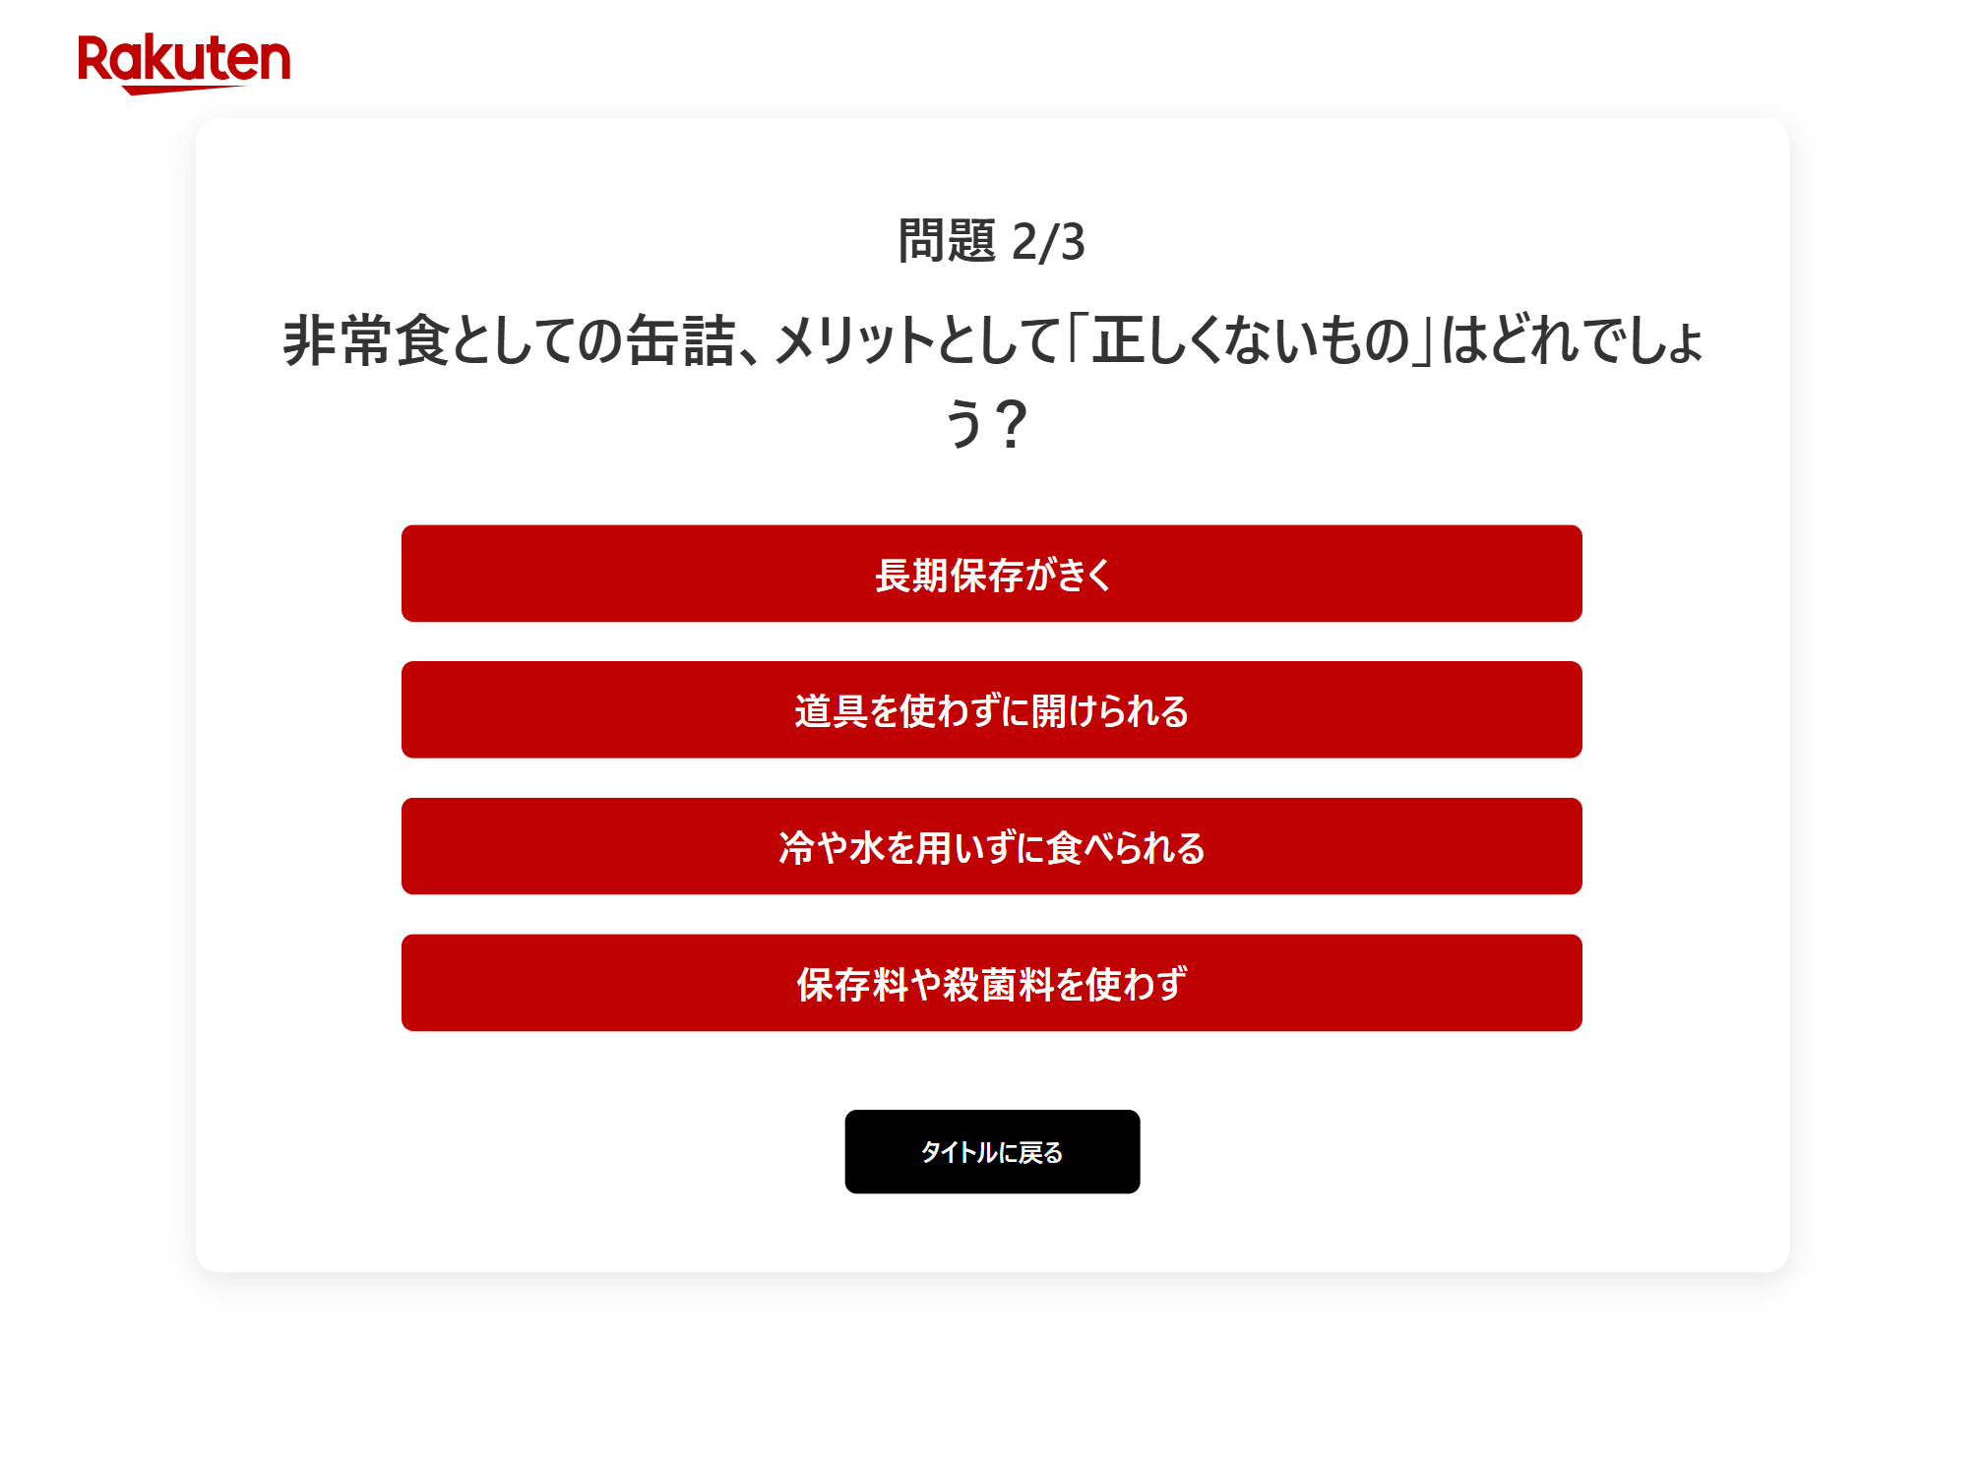
FrontEnd
Team-5
Frontend Features(Quiz Question Screen)
Key Improvements
・The color changes when the choice hovers.
・Added animation where the choices fade in order from top
to bottom.

Slide 13
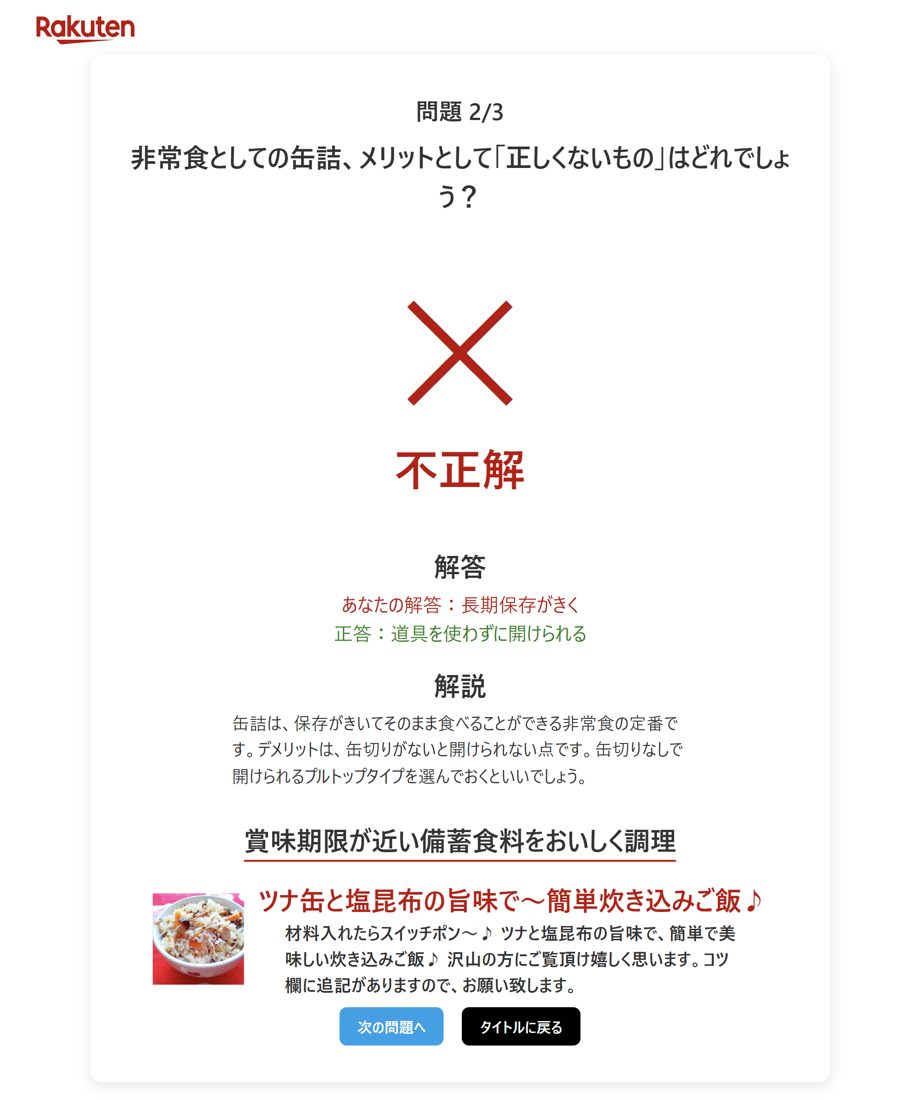
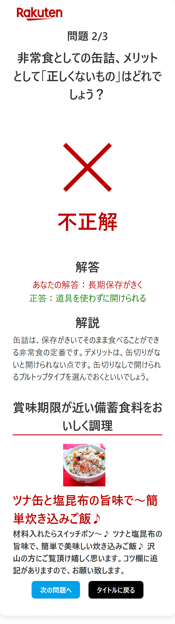
FrontEnd
Team-5
Frontend Features (Result Screen)
Key Improvements
・Separated colors to facilitate visual
distinction between correct and incorrect answers.
・The excitement was heightened by
showing the results of correct
and incorrect answers in animation.
・When you press to the next problem,
you can see it from the top
of the screen, reducing the user's stress.

Slide 14
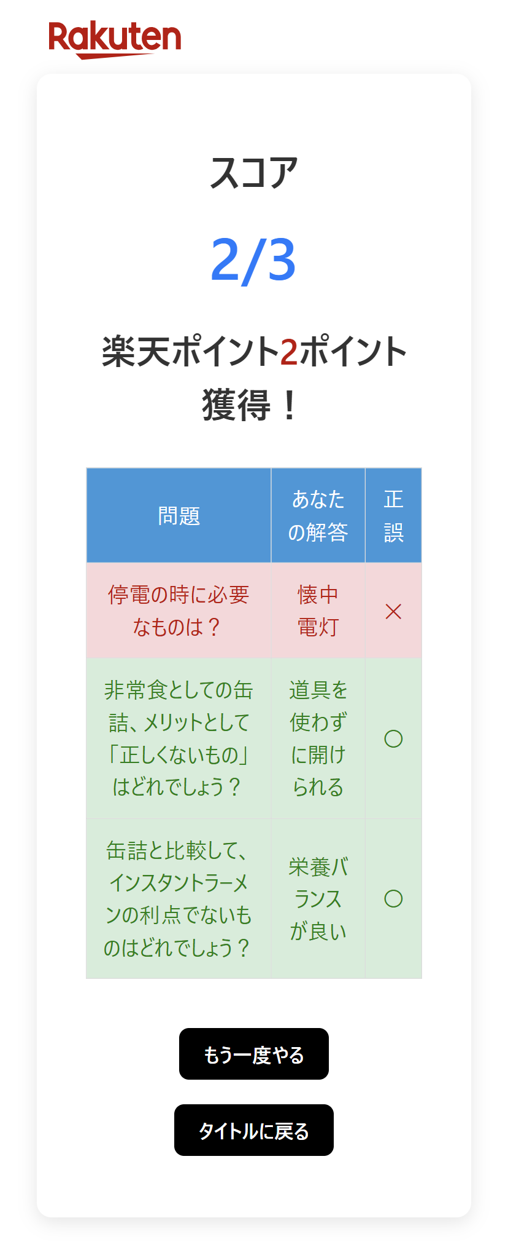
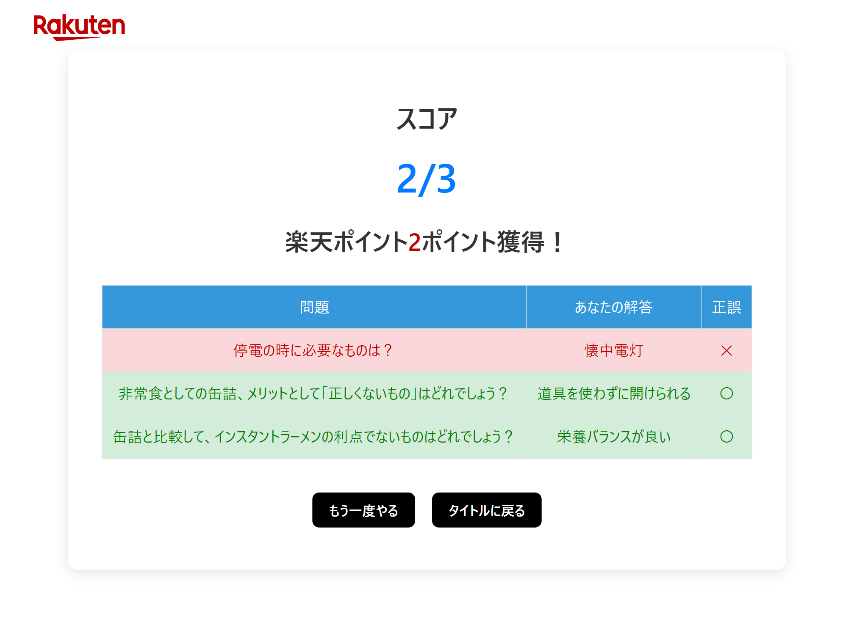
FrontEnd
Team-5
Frontend Features(Score Screen)
Key Improvements
・Animation was added with
a large time difference to
display the score, creating
a sense of tension.
・A list of solved problems was
displayed so that it could be
reviewed.
・Correct and incorrect answers
are color-coded to make it easier
to understand.
Notes:
8:50

Slide 15
Cooperation with Rakuten Services
Team-5
Goal of using Rakuten's API services
Enable users to purchase related disaster relief supplies
Rakuten Market
Provide recommendations to improve the flavor of disaster-proof food
Rakuten Recipe
Core Functions and Main Processes
Use the keyword corresponding to the quiz question as a parameter
Invoke Rakuten's API for information on related products and recipes
Process and display the information to the user
Notes:
Good afternoon everyone, I'm Xu from team-5.
I would like to introduce the API part of our project, which focuses on enhancing disaster preparedness through cooperation with Rakuten's API services.
The main goal of using Rakuten's API services is to empower users to quickly and efficiently purchase essential disaster relief supplies when answering related quiz questions. Ensuring that they are fully prepared for any emergency situation.
Moreover, our project goes beyond just products. We also use the Rakuten Recipe API to provide recommendations on how to improve the flavor of disaster-proof food.
Our process is straightforward yet effective. By using keywords related to quiz questions, our system invokes Rakuten’s API to fetch relevant products and recipes. The information is then processed and displayed in a user-friendly format.

Slide 16
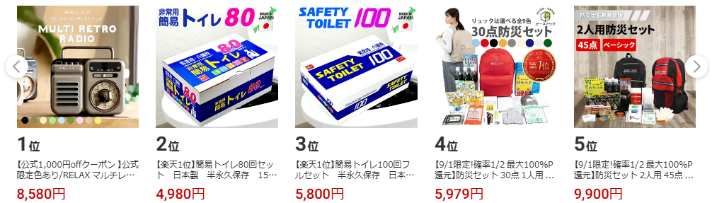
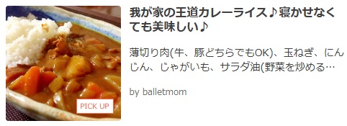
Issues and Solutions
Team-5
Limited API functionality for recipes
Obtain all category information with the API
Match the quiz keywords with the appropriate recipe categories
Form of information
Product list
Recipe card
Notes:
However, we did face some challenges, particularly with the limited functionality of the recipe API. To overcome this, we adapted by obtaining all category information through the API and matching the quiz keywords with the associated recipe categories.
Additionally, the format of displaying the information was also a challenge for us. After looking at Rakuten Market and Rakuten Recipes, we decided to display the products in a list that can be switched between pages, and the recipes in a simple card format.
Thank you.
(10:20)

Slide 17
Server & BackEnd
Team-5
Technologies Used
MySQL: Managing quiz data efficiently.
Node.js: Reading, shaping, and passing data from the server.
Why These Technologies for Our Project?
MySQL is essential for handling large-scale quiz data for future use.
Node.js is crucial for shaping data format and efficiently passing data from the server to front-end.
Notes:
let’s talk about the technologies we used in the server and backend areas. We focused on two main tools: MySQL and Node.js.
MySQL is a database management system that we use for managing quiz data efficiently. We believe it is essential for handling large-scale quiz data for future use as our project grows.
Node.js is a JavaScript runtime environment that we use for reading, shaping, and passing data from the server. It is crucial for shaping data format and efficiently passing data from the server to the front-end.

Slide 18
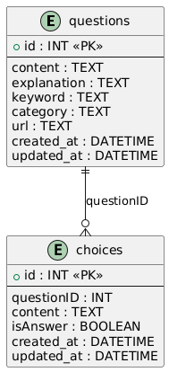
Server : Database Structure
Team-5
Database Overview
One questions table is associated with multiple choices tables.
Class Attribute
content : Text for the question or choice.
explanation : Explanatory text for a question.
keyword : Keywords used for searching products or recipes.
category : Specifies which Rakuten service (API) to use.
Notes:
Next, I’ll provide an overview of our database structure and the attributes.
In our database, each questions table is associated with multiple choices tables. This one-to-many relationship allows us to store multiple possible answers for each quiz question efficiently.
Let’s look at some noteworthy key attributes we’ve defined for these tables:
content: "This attribute holds the text for either the question or the answer choices, depending on the table."
explanation: "Here, we store the explanatory text for each question, providing users with detailed explanations after they’ve answered."
keyword: "This attribute is used for searching products or recipes, making it easier to link quiz content with related items."
category: "Finally, the category attribute specifies which Rakuten service or API, that previously mentioned, to use."

Slide 19
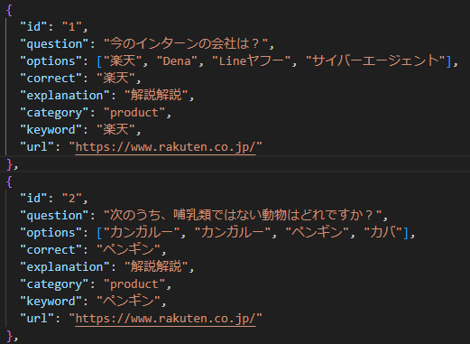
BackEnd : Data Shaping
Team-5
Data Shaping
Combine two tables into a single dictionary list and pass it to the frontend.
Notes:
Next, let’s discuss data shaping and how we prepare our data for the frontend.
We combine two tables into a single dictionary list. This approach allows us to pass and utilize data to the frontend.
(12:15)
demo:(17:20)

Slide 20

Prospects for the future
Team-5
Improve recipe recommendation feature
Automatically identify the categories of recipes
Analyze user interests using AI
More features
Manage users' stock lists
Check evacuation routes
Notes:
Looking ahead, we are excited about the future possibilities of this project.
We plan to utilize advanced tools like Large Language Models to automatically identify the most relevant recipe categories based on quiz questions. This will make our system smarter and more responsive to users' needs.
AI can also be used to analyze users' interests.
Moreover, We want to implement more features such managing users‘ stockpile lists and checking evacuation routes.
(13:00)

Slide 21
Thank you for your listeninng

Slide 22
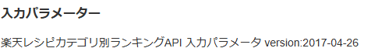
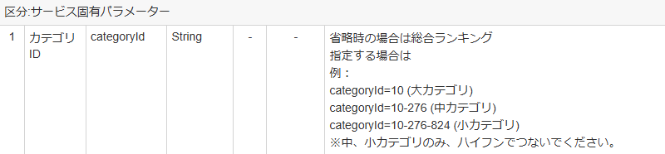
the difficult part
Team-5
Rakuten Recipe API
The input parameter category Id didn't match categories like 'emergency food' or 'alpha rice,’
so, I had to come up with quiz questions based on categories it did support, like 'canned food' or 'instant ramen.'"

